Slide 1
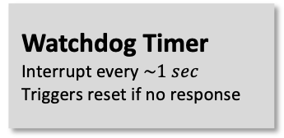


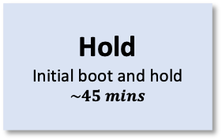
Ground command
Automatic operation
PandaSat CONOPS
Baseline Operations
Early Mission Operations
YES
Detumble
Magnetorquers on
Battery voltage above threshold?
Hold
Initial boot and hold
$$\sim 45 mins$$
Deploy Antenna
1) Check battery voltage
2) Deploy Antenna
YES
YES
Beacon
1) Gather & store data
2) Beacon to ground station
Launch
Deployment from ???
Tumbling too fast?
NO
Every $\sim 1 min$
Battery voltage above threshold?
NO
Sleep
Minimal power mode
Batteries charging
NO
Listen
Listen for uplink
$$\sim 15 secs$$
Payload Operations
Uplink?
NO
Process and Store Data
From payload
YES
Process Uplink
Ability to:
Switch operating mode
Request downlink
Flash from MRAM
Send acknowledgement
NO
Watchdog Timer
Interrupt every $\sim 1 sec$
Triggers reset if no response
Payload On
SDR and Raspberry Pi
YES
NO
Battery voltage above threshold?
YES
Payload operation scheduled now?
Downlink requested?
Downlink
Downlink requested information
YES

